Slide 1
ENERGY MARKETS & COMMODITIES
LNG Market Fundamentals & Asian Arbitrage Dynamics
Physical properties, global trade flows, contract structures, and inter-fuel substitution economics across Asian power & industrial markets.
CORE FOCUS
KEY MECHANICS
GEOPOLITICS
Global LNG Value Chain & Pricing
Coal/LPG Inter-Fuel Switching in Asia
Atlantic vs. Pacific Cargo Spreads

Slide 2



Physical Fundamentals
Cryogenic State to Energy Units
Methane Physics & Unit Conversions
-162°C
1 : 600
0.293 MWh
~1.0 TWh
Cryogenic Condensation
Volumetric Expansion
Energy Standard
Standard Vessel Cargo
Atmospheric liquefaction temperature transforming gaseous methane into dense liquid.
1 m³ liquid methane expands to 600 m³ natural gas at standard temperature & pressure.
1 MMBtu equals ~0.3 MWh (293 kWh). Commercial trading benchmark unit.
Average 174,000 m³ LNGC carries ~0.1 bcm gas (~1.0 TWh energy equivalent).
PHYSICAL STATE
VOLUMETRIC DENSITY
MMBTU CONVERSION
CARRIER CAPACITY

Slide 3
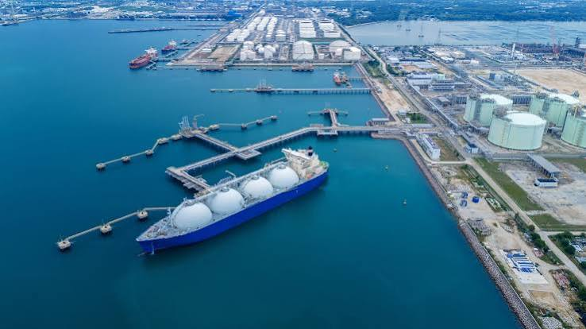
Infrastructure Chain
End-to-End LNG Value Chain Architecture
1. Upstream Production & Liquefaction
Gas extraction, acid removal, cooling down to -162°C via heavy refrigeration trains.
2. Cryogenic Marine Logistics
~800 specialized tankers globally using membrane or Moss tanks with boil-off re-liquefaction.
3. Regasification & Entry Facilities
Onshore terminals & FSRUs warm LNG to vapor, feeding high-pressure TSO networks.
4. Grid Dispatch & Wholesale Hubs
Entry/Exit tariff systems balancing CCGT power generation, industrial & LDZ domestic demand.
Notes:
70 € to liquify / MWh 1€ to regasifiy – 15k - 50k /day to wait on port

Slide 4
Global Flow Balance
Data in Billion Cubic Meters (bcm)
High Supply & Demand Concentration (2025/2026)
Top LNG Exporters Total ~603 bcm
Top LNG Exporters
Top LNG Importers Total ~584 bcm
Total ~603 bcm
Top LNG Importers
Total ~584 bcm
United States
152.8 bcm
European Union (EU)
146.0 bcm
Qatar
112.5 bcm
China
91.1 bcm
Australia
110.8 bcm
Japan
91.1 bcm
Russia
46.2 bcm
South Korea
63.5 bcm
Malaysia
38.2 bcm
India
35.9 bcm
Notes:
Impact on one is very important for the global SnD, 4 bcm can tilt the global SnD – Egypt 2024 becomes importer

Slide 5
Commercial Contracts
Global Pricing Benchmarks & Indexation
North America Benchmark
European Hub Benchmark
Asian Spot & Long-Term
Henry Hub (HH)
Dutch TTF
JKM & Brent Slope
US pipeline gas index. US export contracts are structured as 115% HH + liquefaction toll ($2.25-$3.50/MMBtu).
Primary virtual trading point in Europe. Reflected in DES imports; acts as global market-clearing price floor/ceiling.
S&P Japan Korea Marker for spot cargos. Long-term legacy contracts indexed to Brent crude oil (12%–14.5% slope).
Key trait: Highly liquid, destination-free FOB sales.
Key trait: High liquidity, driver of flexible US cargos.
Key trait: High seasonal premium over Europe.

Slide 6


Market Mechanics
Substitution Triggers
Asian Inter-Fuel Arbitrage: Gas vs. Coal & LPG
Gas-to-Coal Power Switching
Industrial LPG & Fuel Oil Arbitrage
Marginal Cost Parity: Determined by JKM spot price vs. Newcastle Coal price + efficiency differential (CCGT 55% vs. Coal 38%).
Ceramics & Manufacturing: Small-scale Asian industrial users switch between piped natural gas/LNG and Propane/Butane (LPG).
Price Threshold: JKM above $12-$14/MMBtu triggers price-sensitive Asian utilities (India, China, S. Korea) to maximize coal generation.
LPG Discount Floor: When LPG trades at a 15%+ discount to LNG on energy content basis, industrial demand shifts away from LNG.
Demand Elasticity: Coal switching capability creates an upper boundary for spot LNG demand in emerging Asia.
Trucked LNG Impact: Micro-LNG trucked distribution in China dynamically competes with domestic LPG fuel prices daily.
Switching Formula: Coal ($/t) / 24 + Carbon Penalty ≈ LNG Parity ($/MMBtu)
LPG Parity: Propane ($/ton) / 47.6 = Energy Equivalent LNG ($/MMBtu)

Slide 7
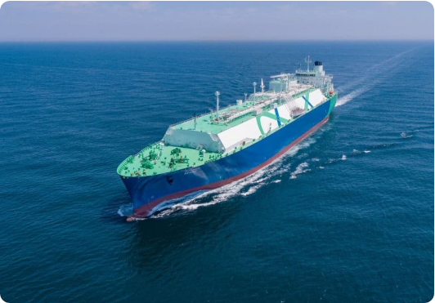
Logistics & Arbitrage
Global Fleet: ~800 Tankers
LNG Carrier Fleet & Shipping Economics
Boil-Off Gas (BOG) & Propulsion
0.10%–0.15% daily cargo boil-off used as propulsion fuel. Modern X-DF / ME-GI engines offer reliquefaction to minimize cargo loss.
Charter Rate Volatility
Spot day-rates range from $30,000/day in off-peak to $250,000+/day in winter squeeze, directly widening US Gulf to Asia transport spreads.
Chokepoints & Route Arbitrage
Panama & Suez Canal bottlenecks dictate US Gulf-to-Asia voyage times (22 days via Panama vs. 35 days via Cape of Good Hope).

Slide 8
Inter-Basin Competition
The Flexible Cargo Balancing Act: TTF vs. JKM
Asia-Europe Arbitrage Window
DESTINATION FLEXIBILITY
Traders redirect uncommitted US cargos based on the spread: JKM - TTF - Freight Differential. If JKM premium exceeds freight costs (~$1.50-$2.50/MMBtu), ships head to Asia.
> 60%
Share of US FOB spot cargos with zero destination restriction clauses
Europe as Market Balancing Sink
Post-2022, Europe replaced Russian pipeline gas with LNG. Europe acts as the default destination when Asian spot demand softens due to coal/LPG switching.

Slide 9
SUMMARY & KEY TAKEAWAYS
LNG Market Fundamentals
Key Takeaways for Energy Traders & Analysts
1. Concentration Risk
2. Asian Price Ceiling
3. US Cargo Arbitrage
Top 3 exporters control ~62% of supply; outage in US or Qatar creates instant global price shocks.
Coal switching in Asian power ($12-$14/MMBtu) & LPG industrial substitution cap spot JKM upside.
Flexible FOB destination contracts mean US LNG acts as the marginal balancing volume between TTF and JKM.
End of Presentation • Q&A Session
Thank You

